Slide 1


Slide 2

Link state routing was introduced to overcome two
primary problems of distance vector routing
Distance vector routing does not take into account the bandwidth when choosing routes.
Distance vector algorithm took too long a time to converge.

Slide 3
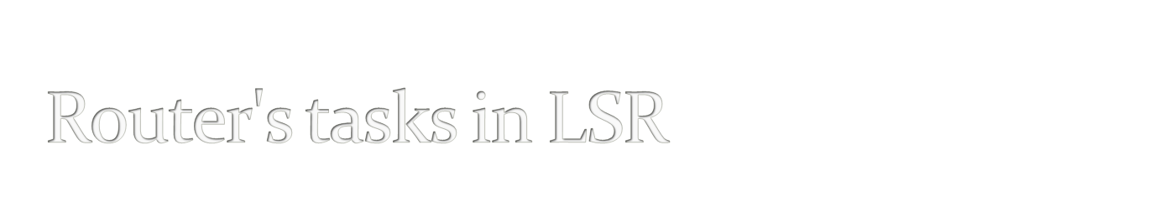
Each router has to accomplish the following tasks
Discover its neighbours and learn their network addresses.
Measure the delay or cost of each neighbour.
Construct a packet with relevant information gathered before.
Send packet to all other routers.
Compute the shortest path to every other router.

Slide 4

When a router is booted, its first task is to learn who its neighbours are.
This is accomplished by sending a special HELLO packet on each point-to-point line.
The router on the other end is expected to send back a reply telling who it is.
The router names must be globally unique.
When two or more routers are connected by LAN, then the LAN itself is considered as a node.

Slide 5
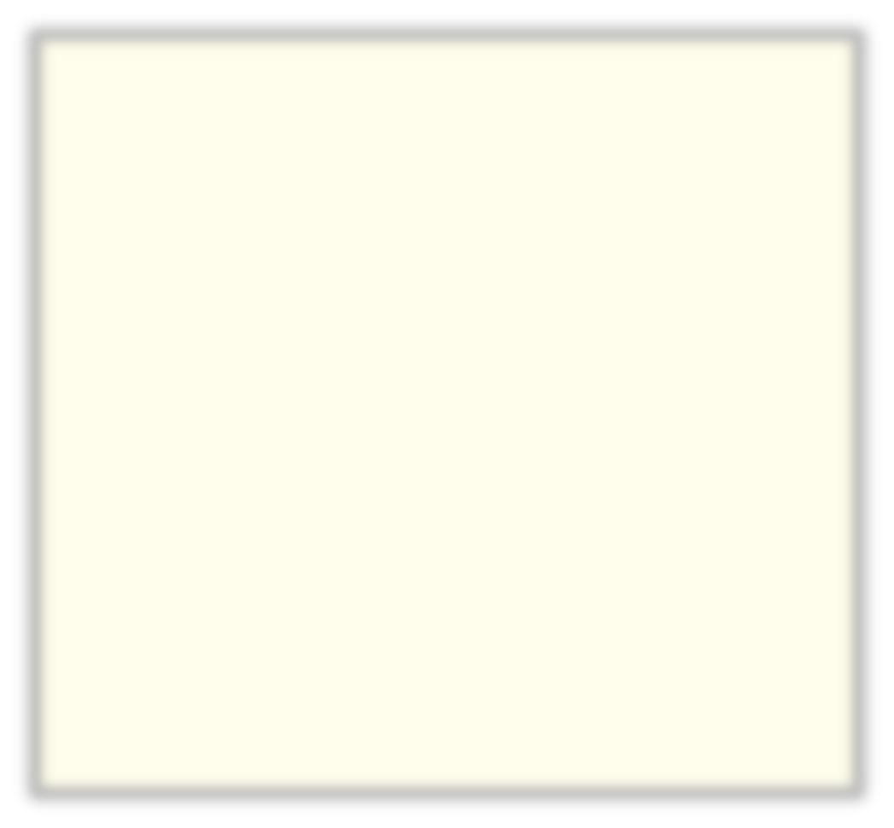
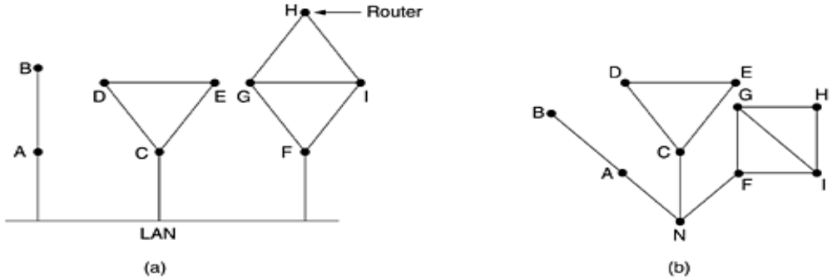
Fig (a) – Nine routers and a LAN
Fig (b) – A graphical model of fig (a)

Slide 6

The LSR algorithm requires each router to know estimate of delay to each of its neighbours.
To do this, it sends a special “ECHO” packet to the neighbouring router, which is required to send back the packet immediately.
By measuring the round trip time and dividing by two, the sending router gets to know the reasonable delay.
For better results the test can be conducted several times and average may be used.

Slide 7

After collection of required information, the router has to construct a packet containing all the data.
The packet contains
Identity of sender
Sequence number
Age
List of neighbours
For each neighbour, the delay to that neighbour.

Slide 8
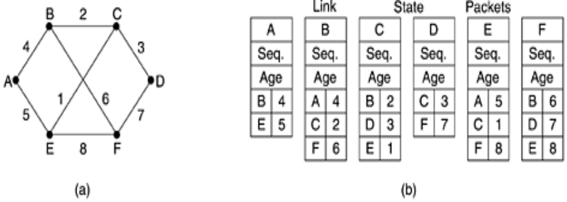

Slide 9
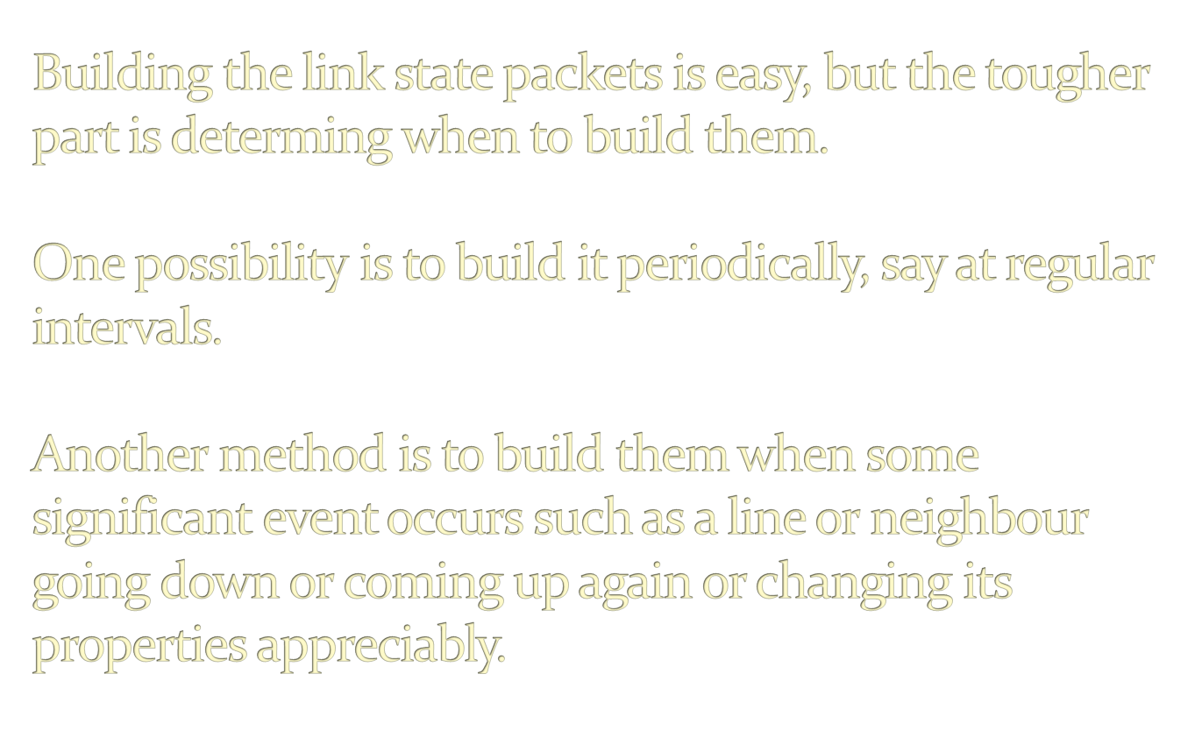

Slide 10

The fundamental idea used here is flooding.
To keep the flood in check, each packet contains a sequence number that is incremented for each new packet sent.
Routers keep track of all the pairs they see.
When a new link packet comes in, it is checked against the list of packets already received.
If it is new, it is forwarded on all lines, except on the line it came from.
If it is a duplicate, it is discarded.
If a packet with a sequence number lower than the highest one seen so far arrives, it is rejected as being obsolete.

Slide 11

Problem a)The sequence number may wrap around.
Solution: Use a 32 bit sequence number so that with one link state packet per second, it would take 137 years to wrap around.

Slide 12

Problem b) If a router crashes, it will lose track of its sequence number.
Problem c) If a sequence is corrupted and say 8390 is received instead of 10 then all packets 11 through 8389 are rejected as obsolete.
Solution: Include the age of each packet after the sequence number and decrement it once per second. When age is zero, information from router is discarded.

Slide 13

When a link state packet comes in to a router for flooding, it is not queued for transmission immediately.
Instead it is first put in a holding area to wait a short while.
If another link state packet from the same source comes in before the first packet is transmitted, their sequence numbers are compared.
If they are equal, the duplicate is discarded.
If they are different, the older one is thrown out.

Slide 14

To guard against errors on the router-router lines, all link state packets are acknowledged.
When a line goes idle, the holding area is scanned in round-robin order to select a packet or acknowledgement to send.

Slide 15

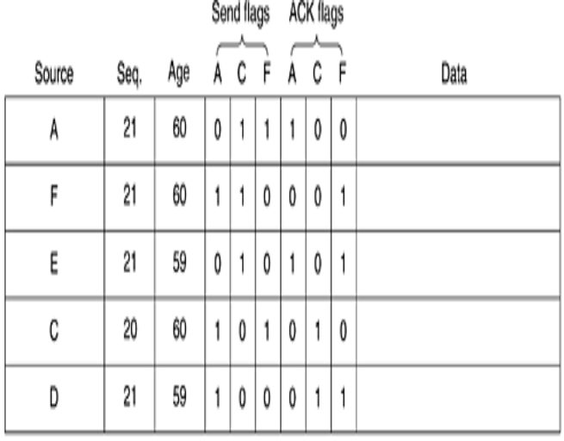
Data structure used for B
Each row corresponds to a link state packet, recently-arrived but not yet fully-processed.
The table records the source of the packet, its sequence number, age and the data.
Additionally, there are send and acknowledgement flags for each router.
The send flags mean that the packet must be sent on the indicated line.
The acknowledgement flags mean that it must be acknowledged there.

Slide 16

Once a router has accumulated a full set of link state packets, it can construct the entire subnet graph because every link is represented.
Every link is represented twice, once for each direction.
Dijkstra’s algorithm can be run to construct the shortest path to all possible destinations.
The results of the algorithm can be installed in the routing tables.

Slide 17

The algorithm was published in open literature, hence the “O” in OSPF.
It supports a variety of distance metrics including physical distance, delay and so on.
It is a dynamic algorithm, meaning that it can be adopted to changes in topology.
It supports routing based on type of service.
It also does load balancing i.e. splitting the load on multiple lines.
It supports hierarchical systems.
It provides security in the sense that sending false information can be avoided.

Slide 18
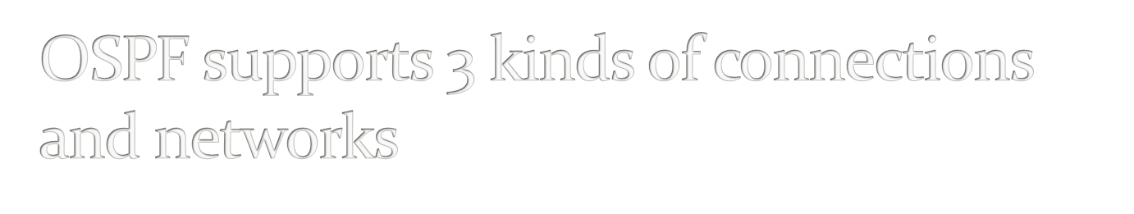
Point-to-point lines between exactly two routers.
Multi-access networks with broadcasting eg.,LANs
Multi-access networks without broadcasting eg., most packet switched WANs

Slide 19
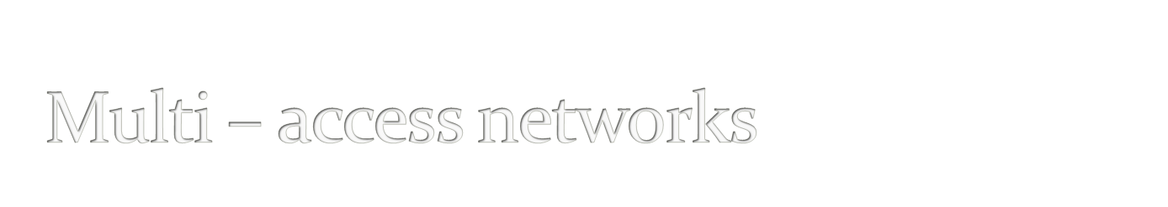
A multi-access network is one that can have multiple routers on it, each of which can directly communicate with all the others.
All LANs & WANs have this property.

Slide 20
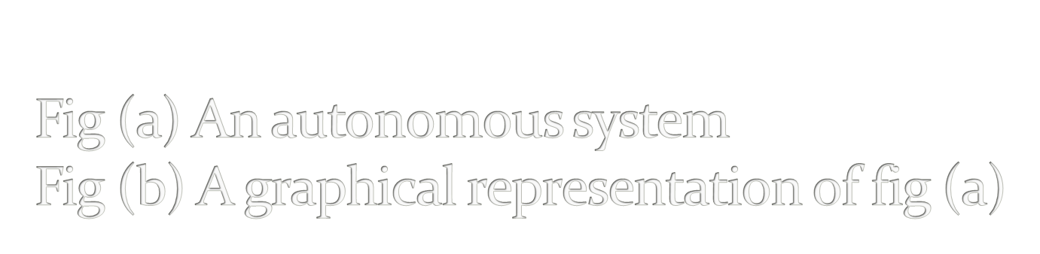
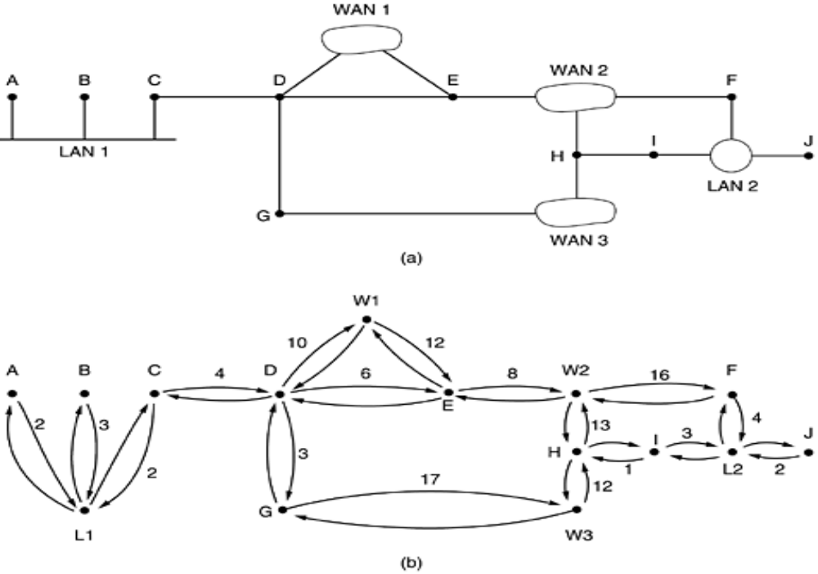

Slide 21
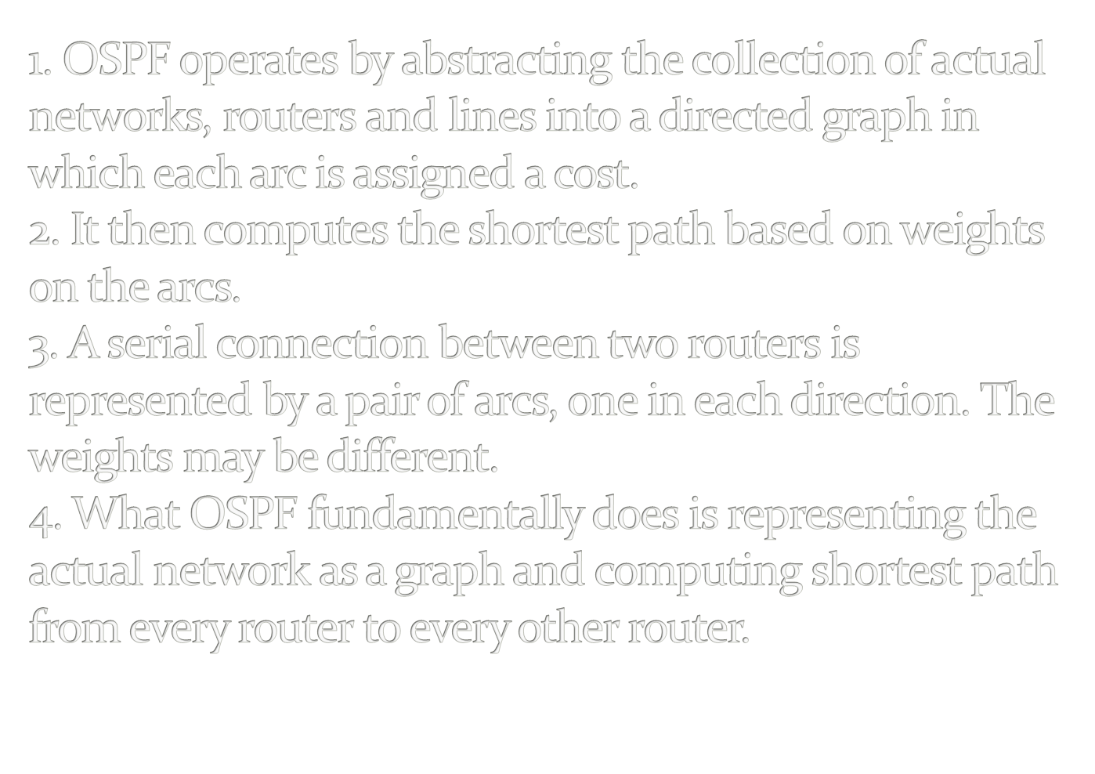

Slide 22

An area is a network or a set of contiguous networks.
Areas do not overlap but need not be exhaustive, that is some routers may belong to no area.
Area is a generalization of a subnet.
Outside an area its topology and details are not visible.
Every AS has a backbone area, called area 0.
All areas are connected to the backbone by tunnels so that it is possible to go to any area in the AS to any other area in the AS via backbone.
Within an area, each router has the same link state database and runs the same shortest path algorithm.
A router that connects two or more areas must run the shortest path algorithm for each one separately.

Slide 23

Internal routers are wholly within one area.
Area border routers connect two or more routers.
Backbone routers are on the backbone.
AS boundary routers talk to routers in other ASs.

Slide 24

When a router boots, it sends HELLO messages on all of its point to point lines and multicasts them on LANs to the group consisting of all other routers.
OSPF works by exchanging information between adjacent routers.
One router is elected as the designated router and is said to adjacent to all other routers on its LAN and exchanges information with each other.
Neighbouring routers that are not adjacent do not exchange information from each other.
A back up designated router is always kept , to ease the transition, even if primarily designated router crashes it can be replaced with the backup router.

Slide 25

During normal operation, each router periodically floods LINK STATE UPDATE messages to each of its adjacent routers.
DATABASE DESCRIPTION messages give the sequence numbers of all the link state entries currently held by the sender.
Either partner can request link state information from the other one by using LINK STATE REQUEST.
The result of this algorithm is that each pair of adjacent routers checks to see who has the most recent data and new information is spread throughout this way.

Slide 26

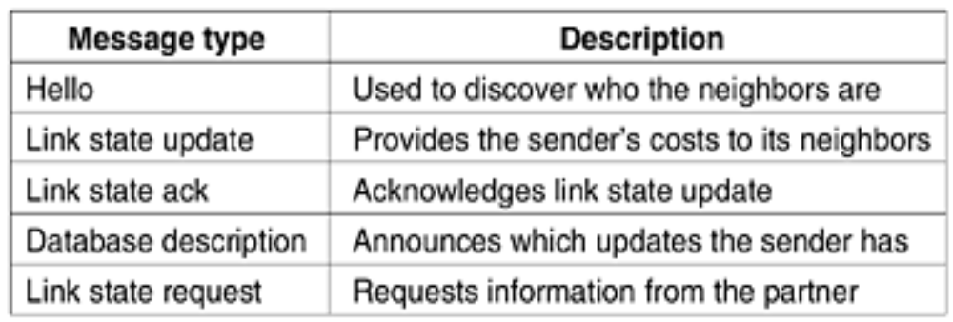

Slide 27
Summary of operation of OSPF:
Using flooding, each router informs all the other routers in its area of its neighbors and costs.
The backbone area collects this information, which allows each router to construct the graph for its area(s) and compute the shortest path.
The backbone routers accept information from the area border routers in order to compute the best route from each backbone router to every other router.
This information is propagated back to the area border routers, which advertise it within their areas.
Using this information, a router about to send an interarea packet can select the best exit router to the backbone.

Slide 28
Advantages:
Security:
All exchanges between routers are authenticated
Multiple same-cost paths:
Allows multiple paths to be used, when multiple paths to a destination have the same cost
Integrated support for unicast and multicast routing
Support for hierarchy within a single routing domain
Versions:
Version 1 – RFC 2238
Version 2 – RFC 2328

Slide 29
COMPARISON OF RIP VERSION 1 & OSPF
FEATURES | RIP 1 | OSPF
Algorithm | Distance Vector
Metric | Hop Count | Link cost
Open standard or Proprietary | Open (RFC 1058) | Open (RFC 2238) Proprietary (RFC2328)
Sends periodic updates | Yes (every 30 seconds) | No
Full or Partial Routing Updates | Full | Partial
Sends updates as broadcast or multicast | Broadcast | Multicast
Metric considered to be “infinite” | 16 | 16,777,215 (2²⁴-1)

